Slide 1


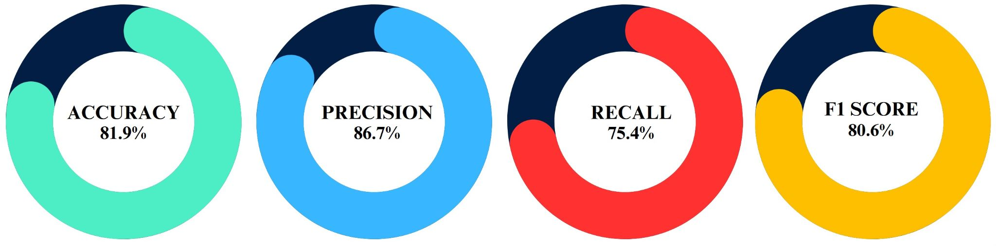
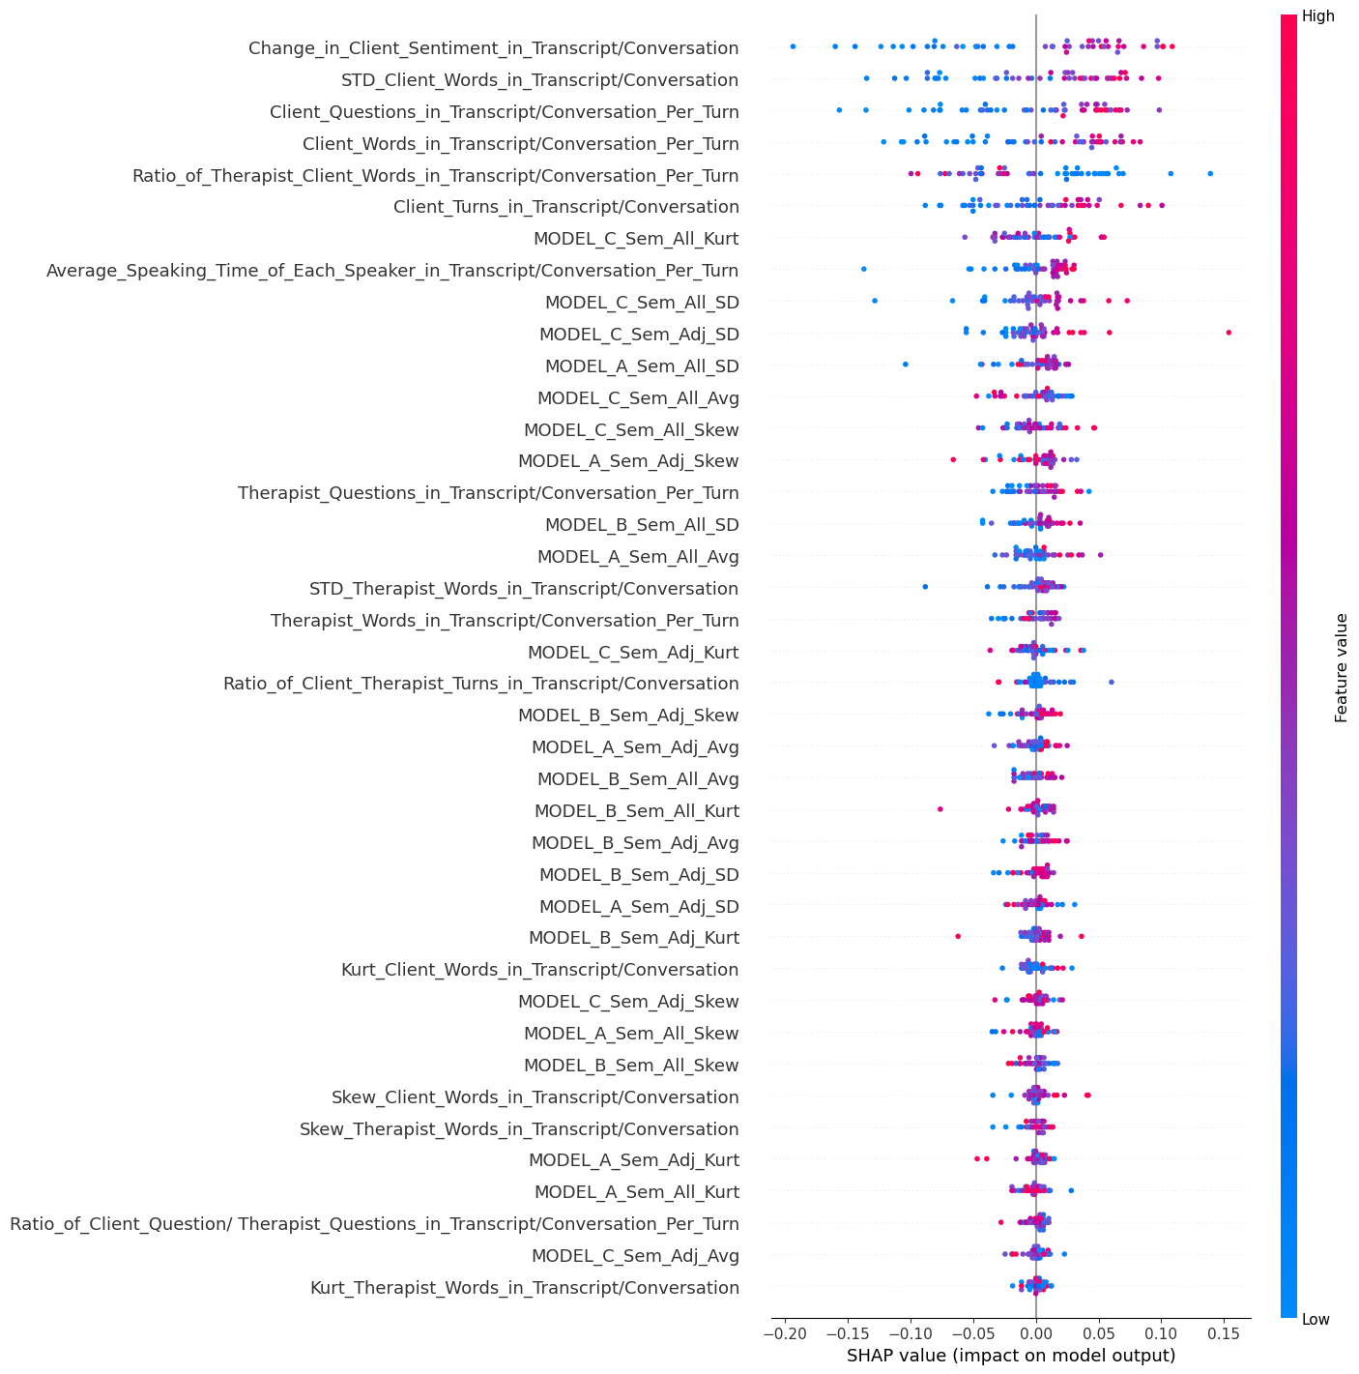
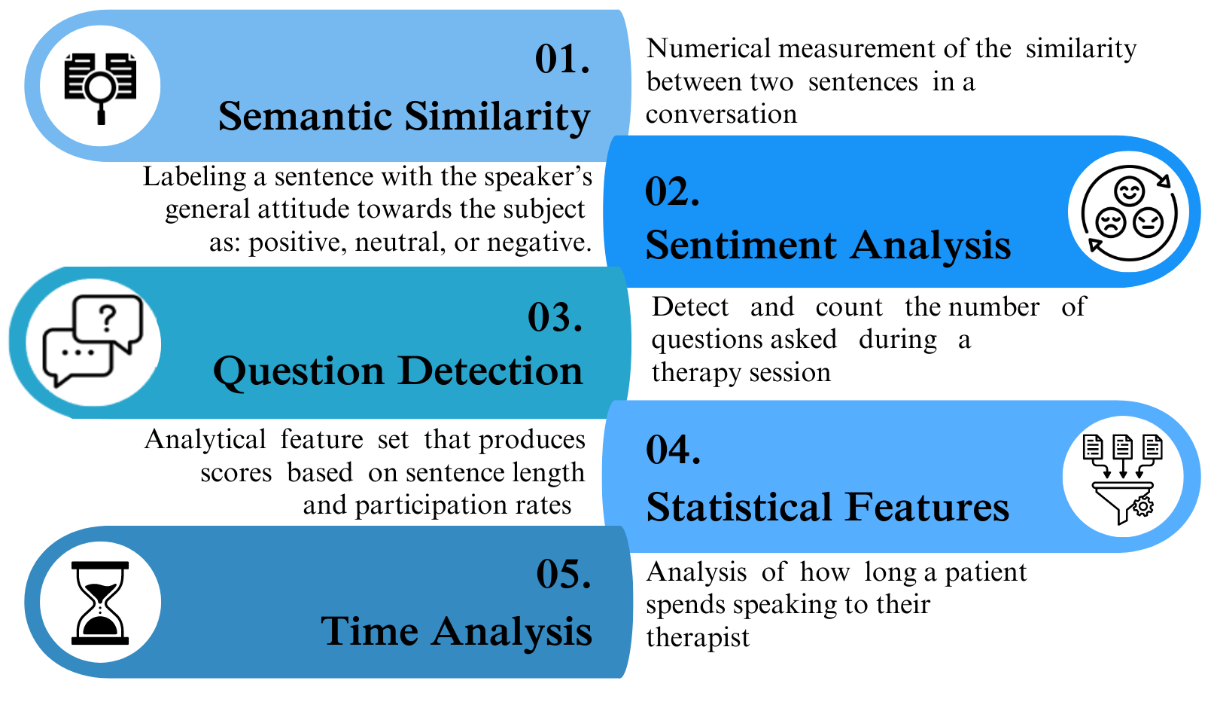
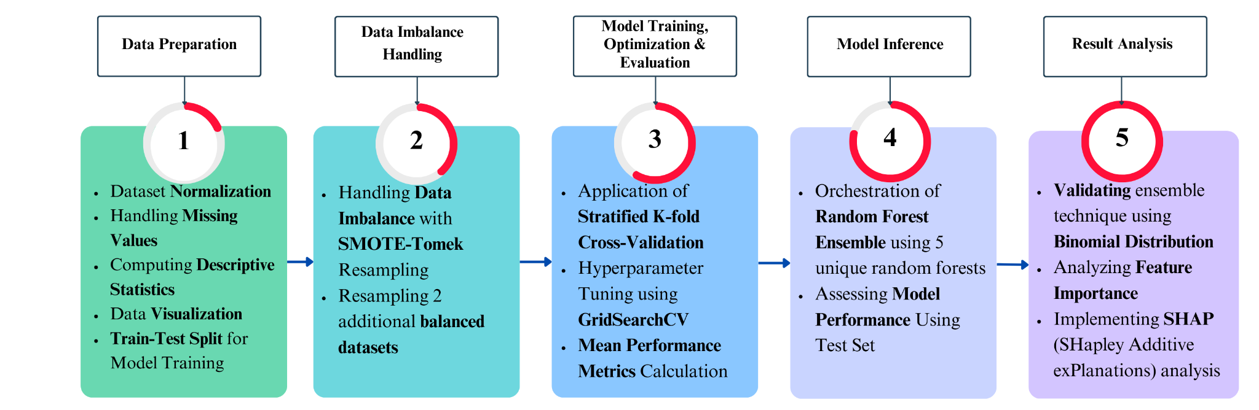
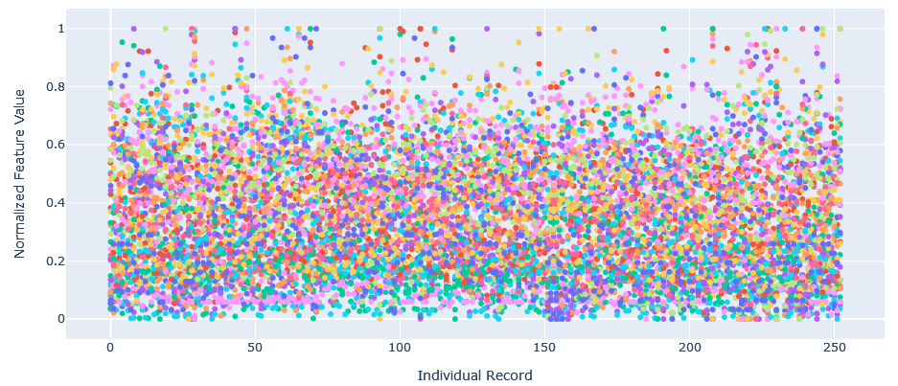
Multi-Dimensional Natural Language Processing Framework
Dylan Weston, Niloy Roy, Sarmed Shaya, Zachary Cote
Department of Electrical, Computer & Biomedical Engineering
Title of the project
Name of the authors
Objective
The primary objective of this project is to enhance the effectiveness of therapeutic sessions by analyzing the dynamics of conversations between therapists and clients. Specifically, we aim to discern between effective and ineffective interactions based on the level of engagement between the two interacting parties. Through the application of Natural Language Processing we created a framework to achieve our goal.
Motivation
Evaluation
This project presents a novel approach aimed at assisting therapists in evaluating the effectiveness of their client conversations through the utilization of 'engagement' scores within an intuitive interface. By leveraging research indicating a strong correlation between client engagement and positive health outcomes, our proposed method seeks to provide therapists with valuable insights into the quality of their interactions.
Engagement Classifier Mean Performance Metrics
Approach
Innovative Model Ensemble Technique
Dataset
The dataset used for the project was retrieved from the High-Low motivation study and included 253 transcripts of mock therapist client interviews posted on youtube [1].
The proposed model ensemble technique effectively combines the diverse perspectives captured by each model, resulting in more robust and accurate predictions for new inputs. Additionally, the effectiveness of this ensemble approach finds support in the principles of Binomial Distribution. With an average accuracy of 81.90% across five models in a 5-fold cross-validation, the probability of obtaining at least three correct predictions out of five is calculated to be 95.56%.
Feature Engineering
Making use of various techniques in Natural Language Processing (NLP), we developed and extracted quantitative features from text based therapy transcripts. Utilizing a mix of custom made features and pre-trained NLP models, we are able to extract 42 features for use in training and inference with the machine learning classifier.
Five Key Feature Areas
SHAP
(SHapley Additive exPlanations) analysis probes into individual predictions, quantifying the significance of each feature through its SHAP value. Positive values highlight features that amplify the model's prediction and negative values signifying features that diminish it.
Machine Learning Model Development Steps
Conclusion
The increasing prevalence of mental health challenges highlights the pressing demand for advancements in treatment methodologies globally. At the heart of therapy lies the pivotal relationship between client and therapist, particularly the dynamics of client engagement. Our study offers dual contributions to the field of engagement quantification. Firstly, we present an innovative NLP-based framework for quantifying engagement, serving as the foundation for a decision support tool tailored to clinicians managing mental health patients. Secondly, we introduce an updated dataset for consultation quality assessment, now enriched with engagement metrics, thus enhancing its utility in evaluating consultation dynamics.
Reference:
[1] Pérez-Rosas, V., Wu, X., Resnicow, K., & Mihalcea, R. (2019). What Makes a Good Counselor? Learning to Distinguish between High-quality and Low-quality Counseling Conversations. In A. Korhonen, D. Traum, & L. Márquez (Eds.), Proceedings of the 57th Annual Meeting of the Association for Computational Linguistics (pp. 926–935). Florence, Italy: Association for Computational Linguistics. DOI:10.18653/v1/P19-1088
Notes:
‹#›

